Slide 1
INVENTORY MANAGEMENT SYSTEM
Project Prepared by:
Doshi Keyur
Project ID-52
Internal Guide: External Guide:
Mr. Avalik Ranpura Mr. Amit Kundalia
Project Prepared for:
ESKAY INDUSTRIES

Slide 2
WHAT?
It is a software used in warehouse operations, and elsewhere, to monitor the quantity, location and status of inventory.
The Inventory System is maintained within a data base that ties an asset to its owner and defines the location where the asset resides.

Slide 3
WHY?
Monitor the Quantity
Systematic Review
Easy and Efficient storage of Information
Storage of Information for Long Time
Trustworthiness

Slide 4
HOW?
For developing this Software it requires Microsoft Visual Studio 2008(or Latest Version) and SQL Server 2005(or Latest Version)
At Client Side to run this software Common Language Runtime is required

Slide 5
FEATURES
Store Details of Material
Store Details of Customer
Track the Material
Store Details of Inward
Store Details of Outward
Using this Details ,it will calculate net material available at company

Slide 6
CONSTRAINTS
Hardware Limitation
Interface to Other Application
Reliability Requirements
Safety and Security Consideration
Dependencies and Assumptions

Slide 7
MAIN MODULE
Inward
Outward
Inventory
Material Information
Sales Order
Report Generation
Customer Information

Slide 8
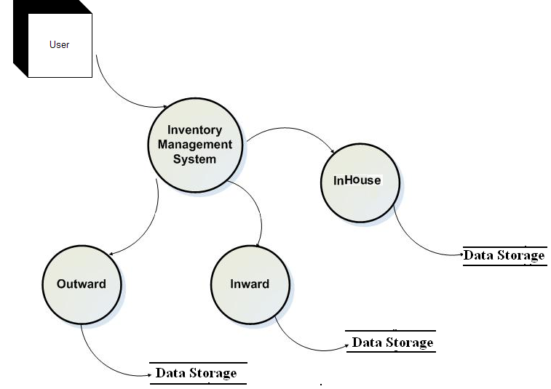
DFD

Slide 9
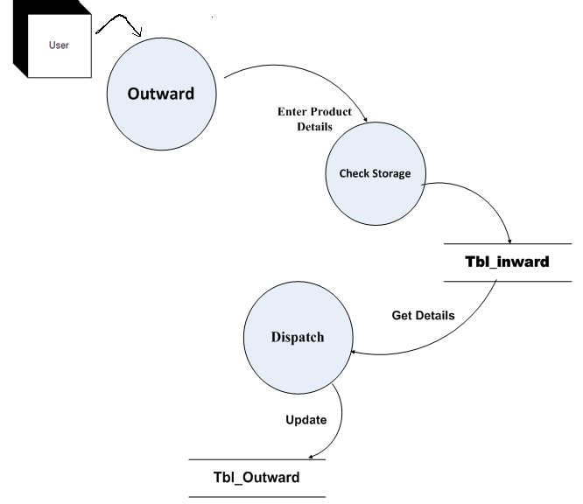
Outward

Slide 10
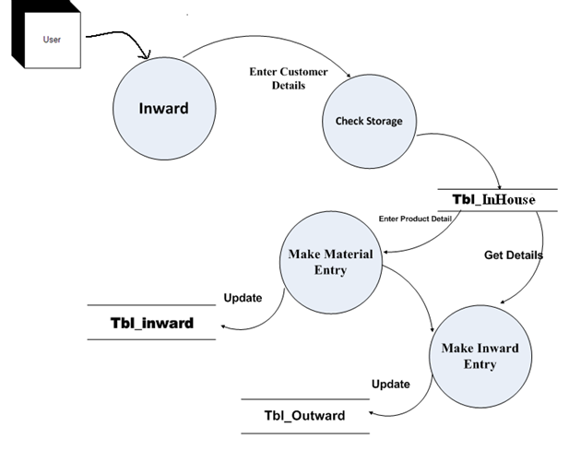
Inward

Slide 11
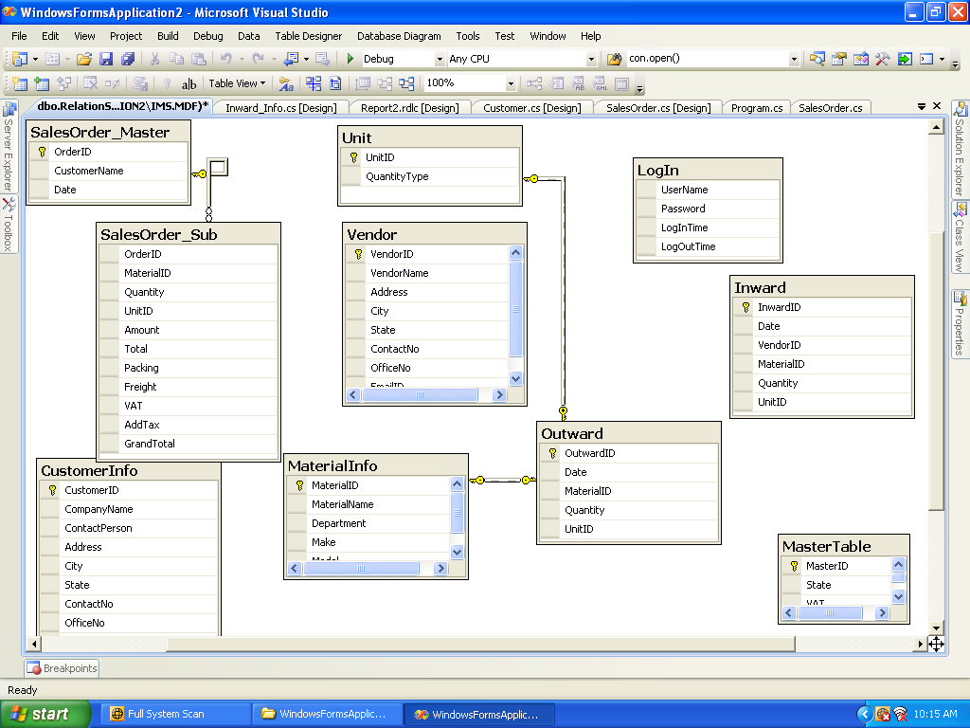
TABLE RELATIONSHIP

Slide 12
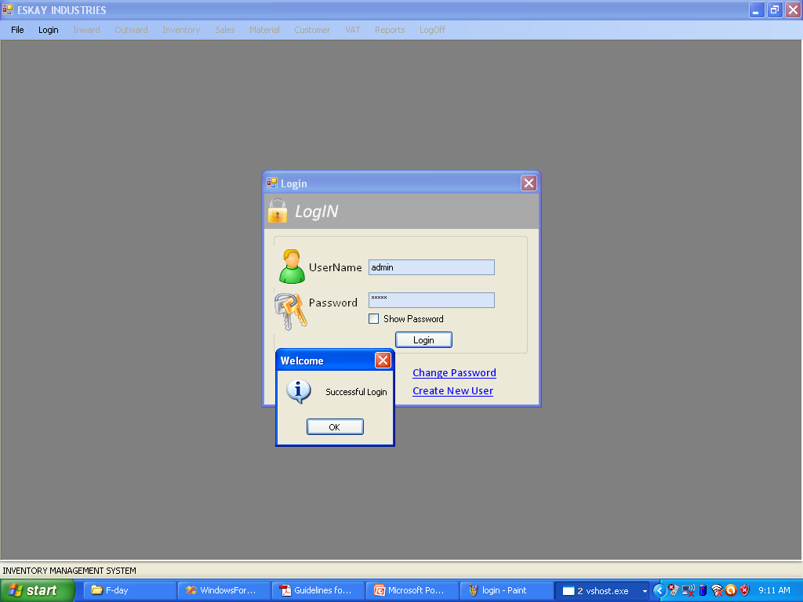
SNAPSHOTS

Slide 13
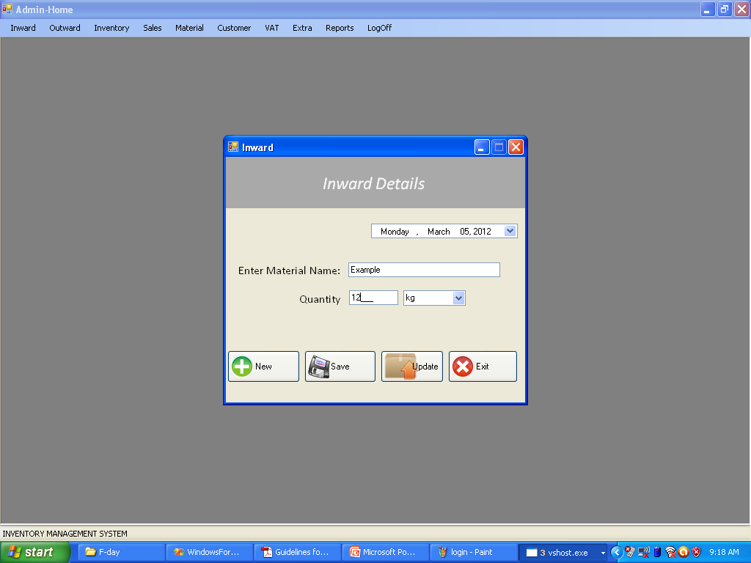
INWARD ENTRY

Slide 14
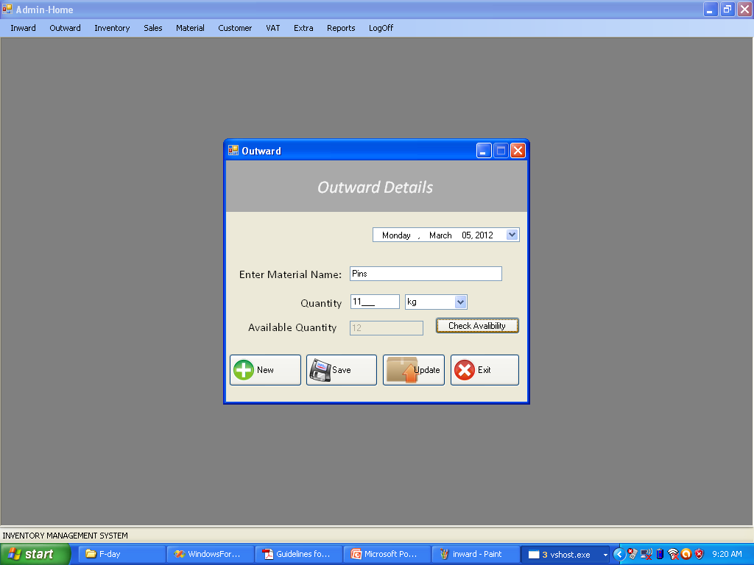
OUTWARD ENTRY

Slide 15
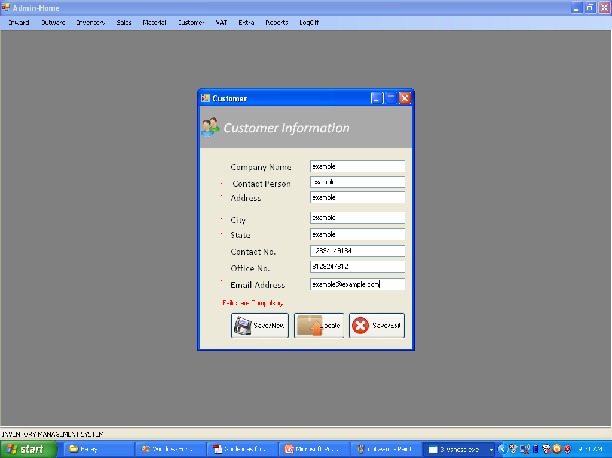
CUSTOMER INFORMATION

Slide 16
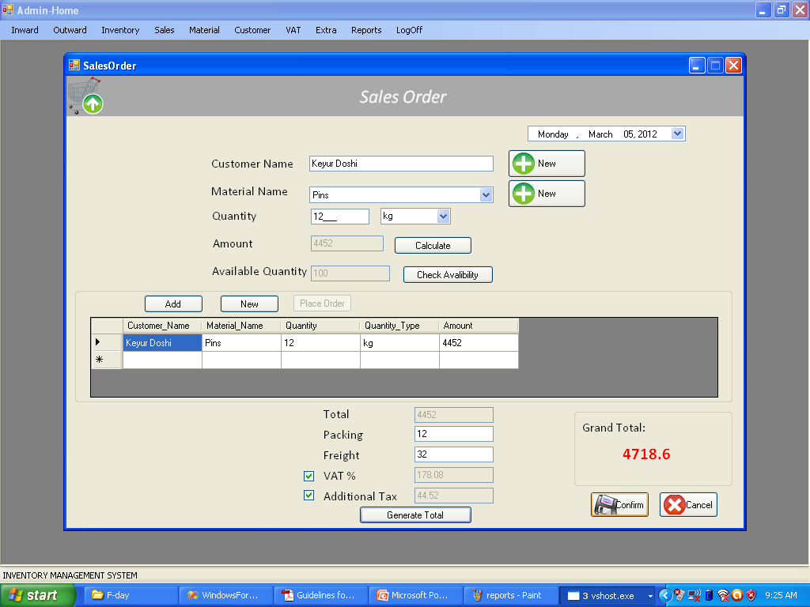
SALES GENERATION

Slide 17
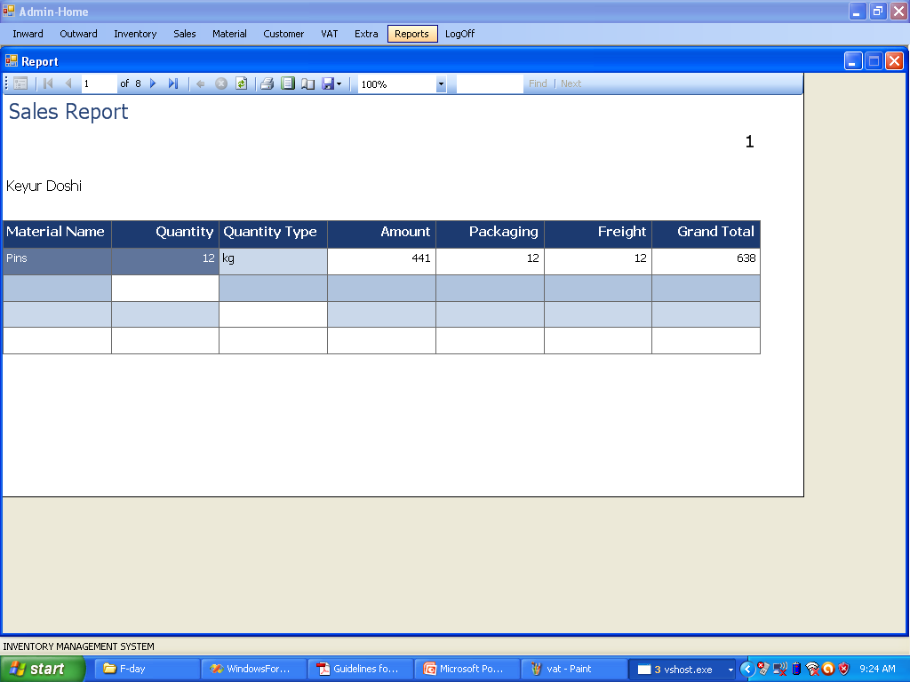
REPORT GENERATION

Slide 18
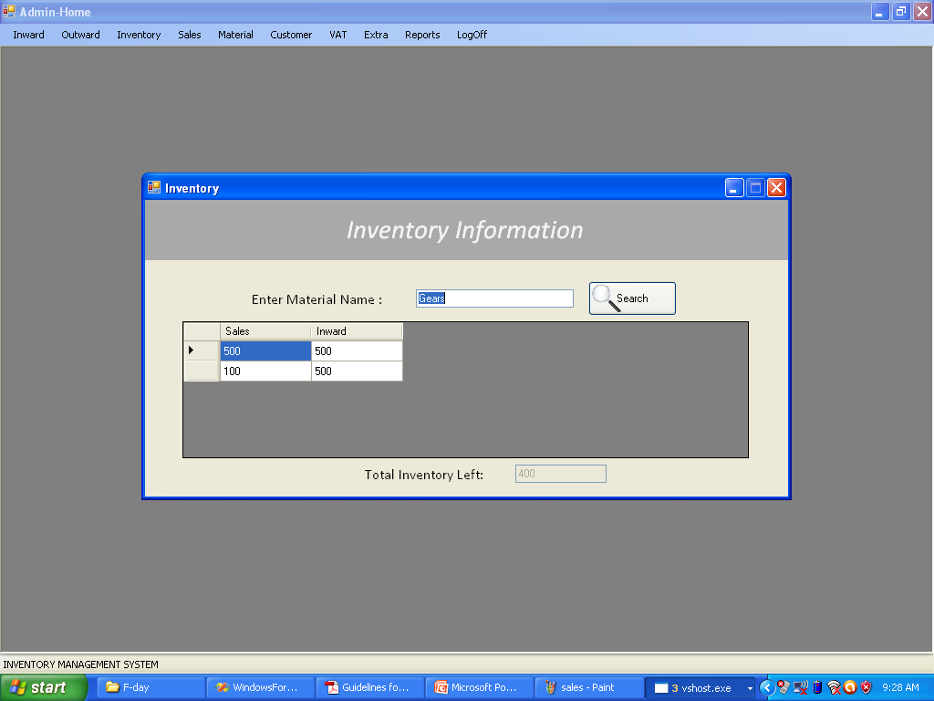
INVENTORY

Slide 19
FUTURE ENHANCEMENTS
The implementation of alerts and notifications in the current system.
The Online Implementation of System can also be possible.
Integration with Sales and Purchase Inventory System

Slide 20
THANK “u”
ANY “?”

